Slide 1
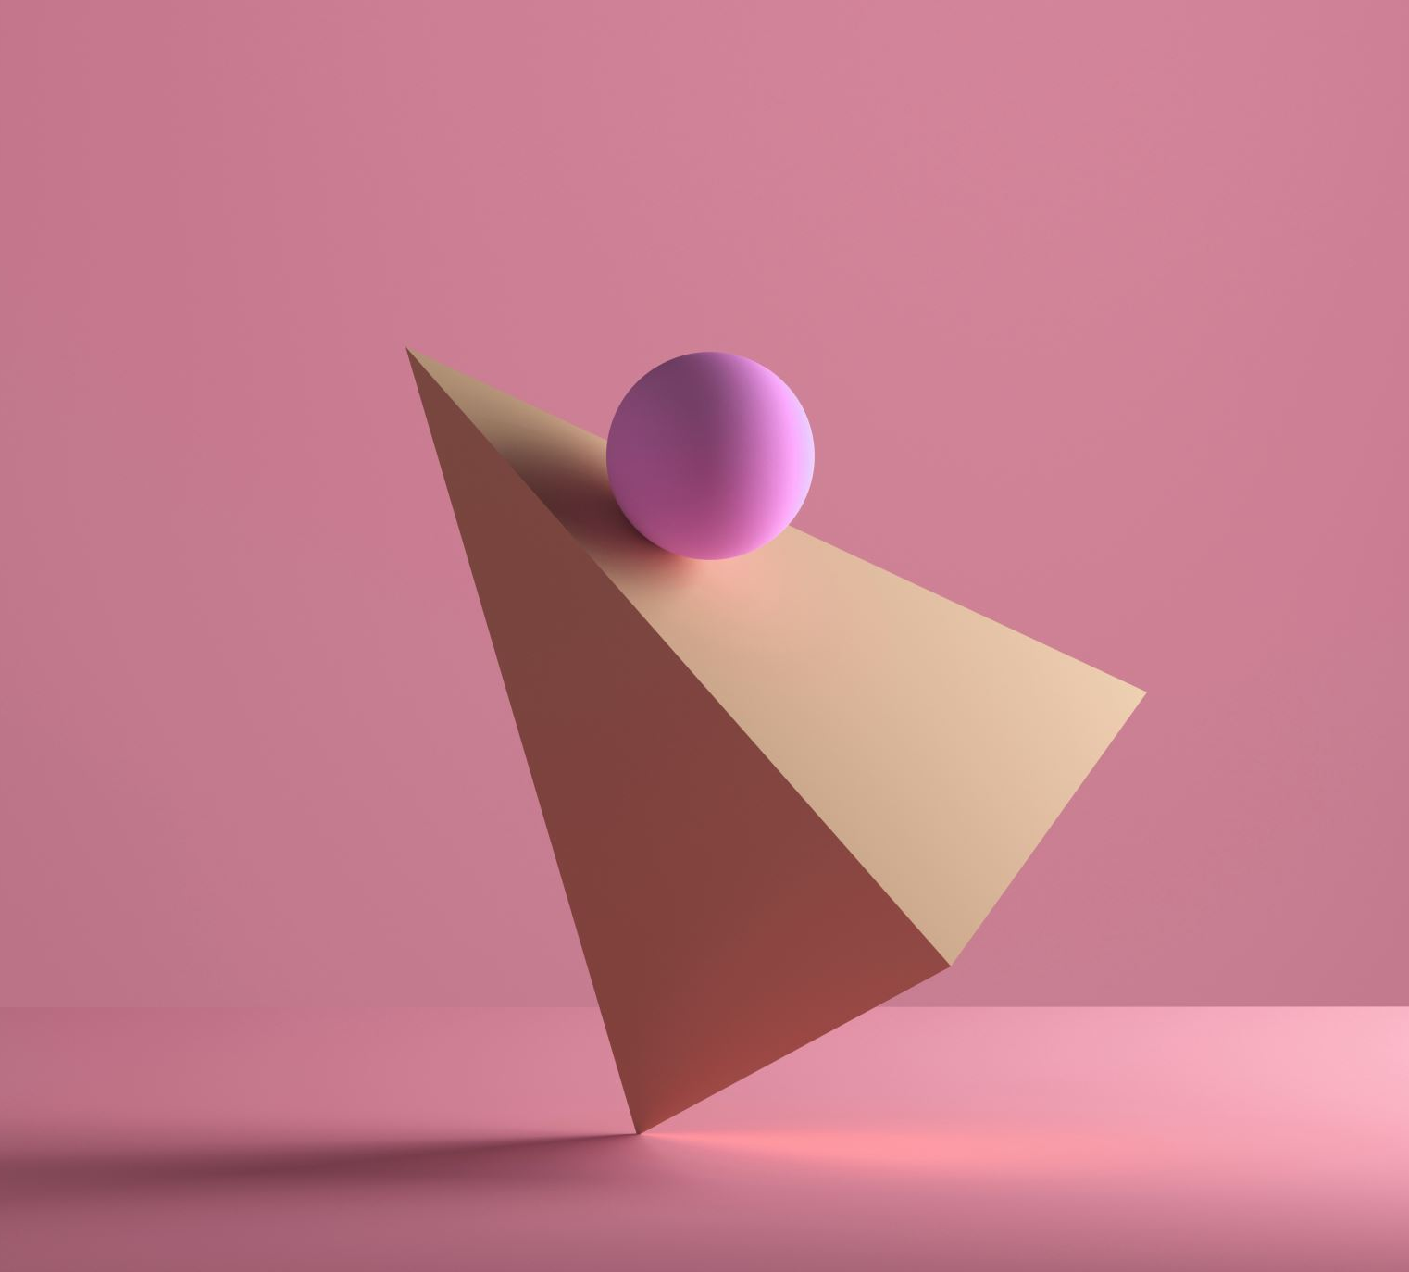
8-QUEENS PUZZLE
ANCHI DUEÑAS HAIRTON ANDREE
20182711J

Slide 2
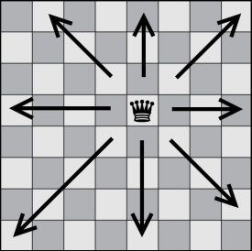

Slide 3
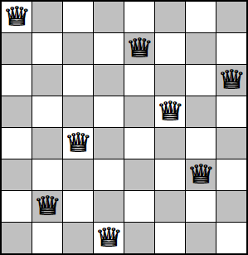

Slide 4
GENETIC

Slide 5
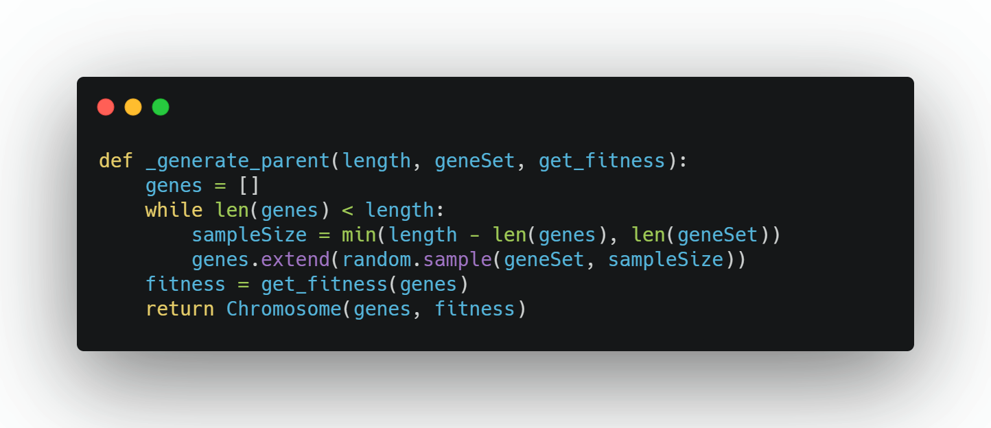
GENERATE PARENT

Slide 6
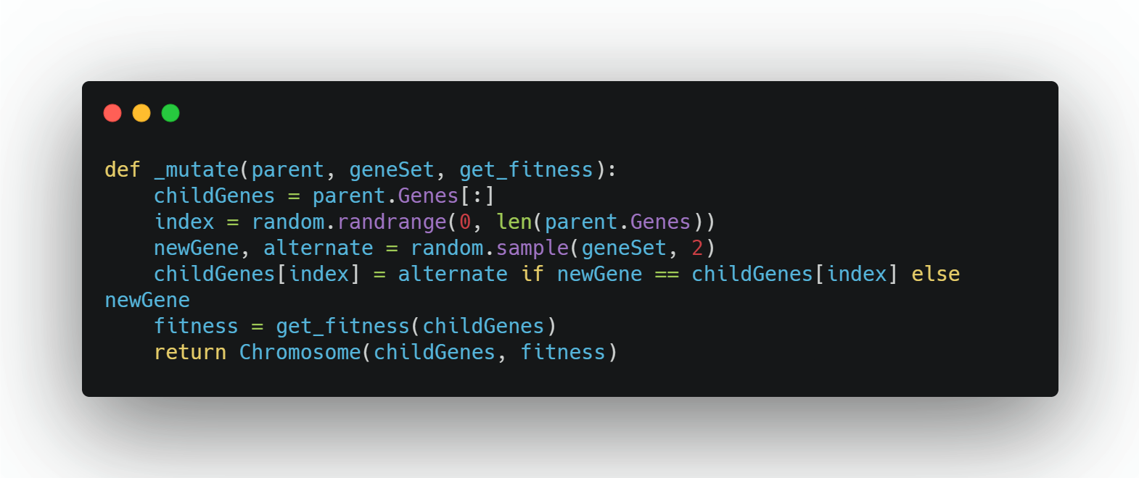
MUTATE

Slide 7
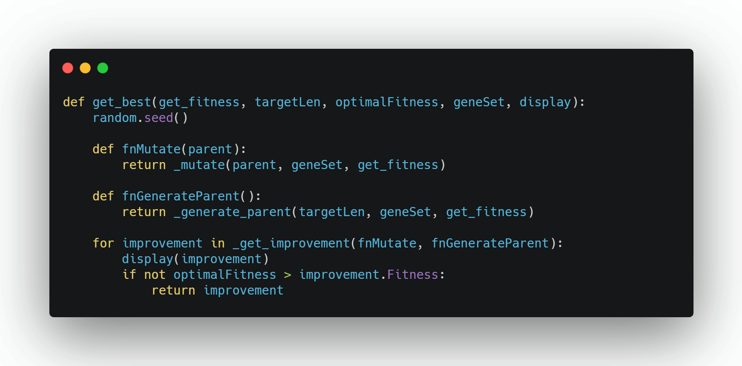
GET BEST

Slide 8
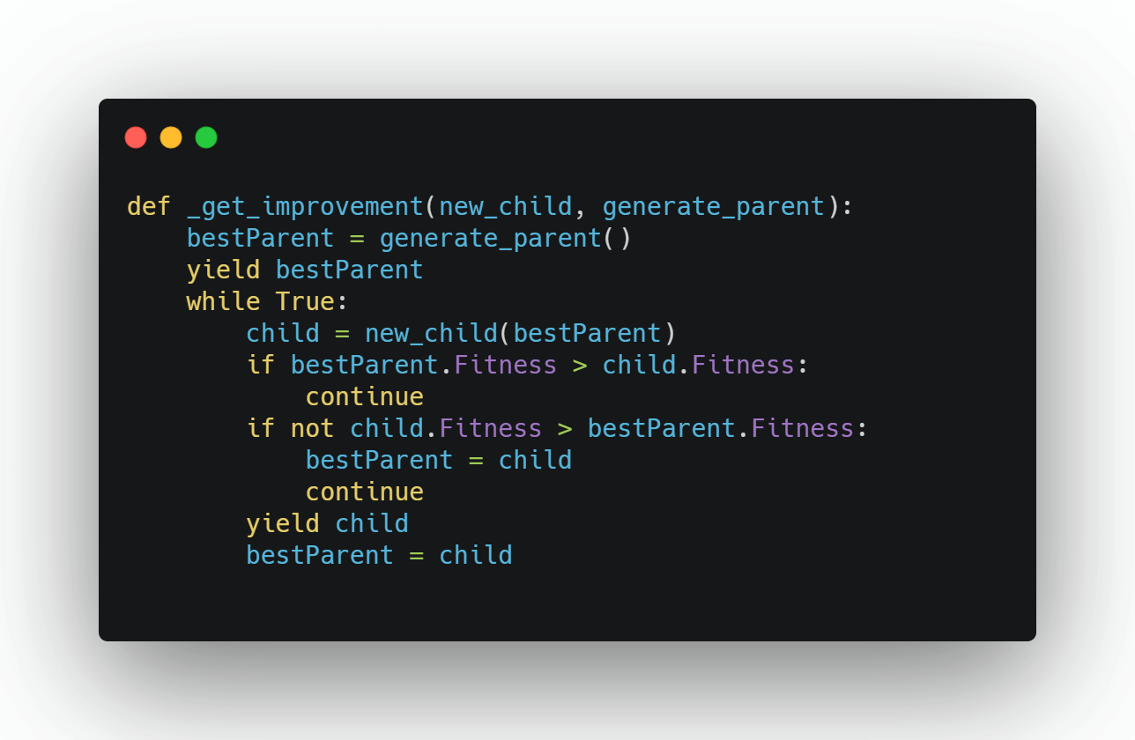
GET IMPROVEMENT

Slide 9
BOARD//DISPLAY

Slide 10

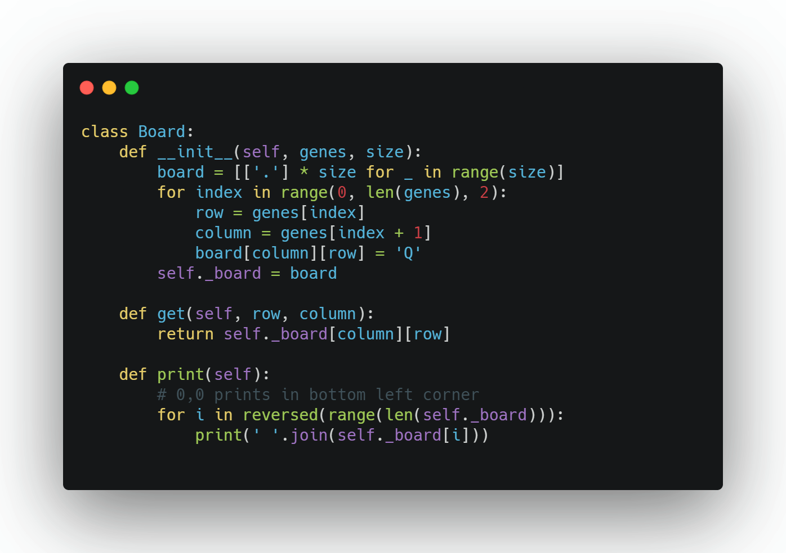
BOARD

Slide 11
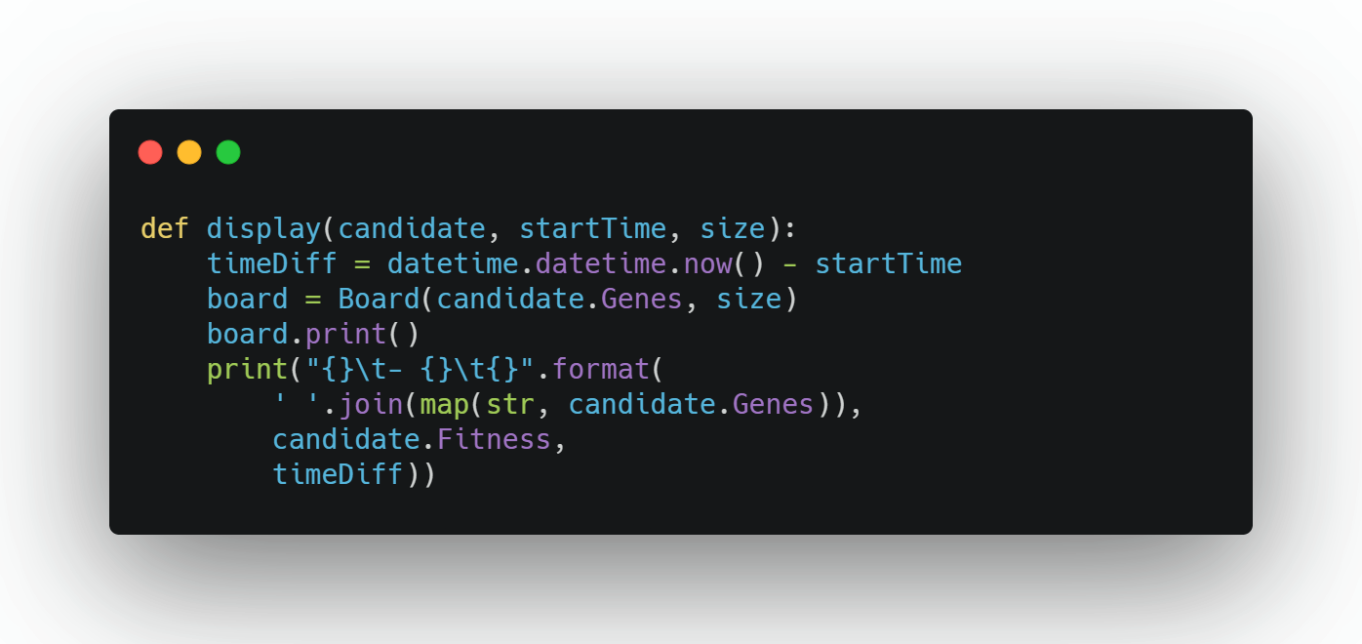
DISPLAY

Slide 12
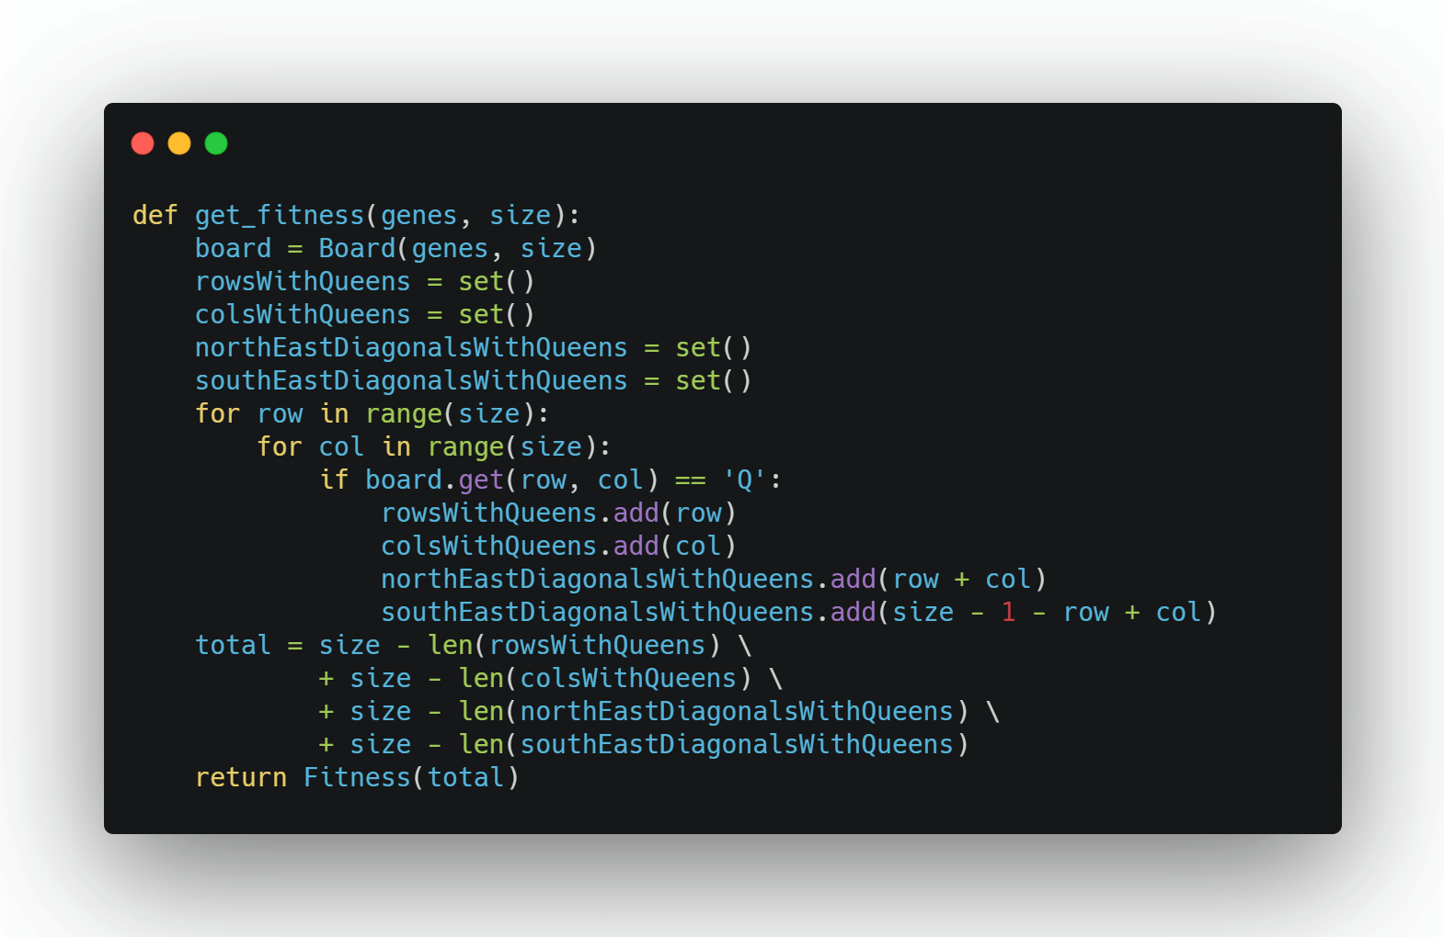
GET FITNESS

